Slide 1
UNIT 8: PHYSICS AND THE BUILD PROCESS

Slide 2
UNIT DESCRIPTION
Activities in this unit of study place emphasis on managing the build process within game creation. Learners will develop skills through a project approach in a team environment as they create a simple 2D/3D game from an existing game template.

Slide 3
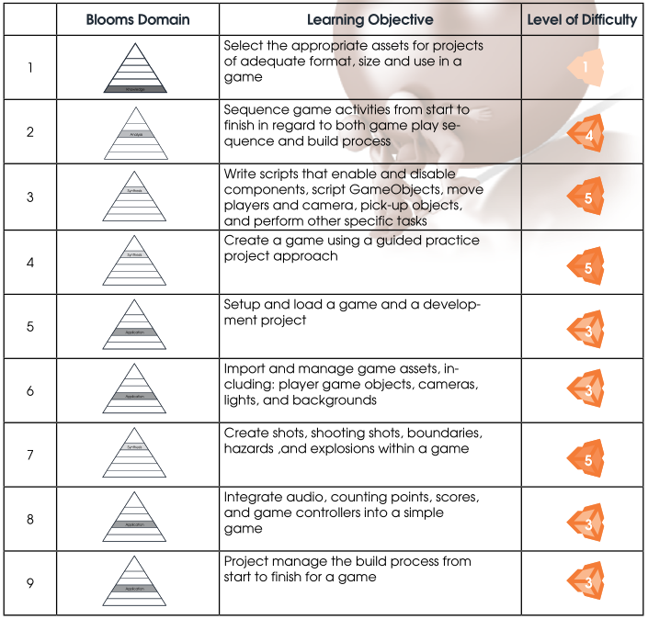
LEARNING OBJECTIVES

Slide 4
COURSE OUTLINE

Slide 5
1. Managing the Build Process:
a. WIPs (Work in Progress)
b. Quality Assurance
c. Development Milestones

Slide 6
2. Building a Simple Game (Guided Practice)
a. Setting Up a Project
b. Add The Player Game Object
c. Add Cameras and Lighting
d. Add a Background
e. Move the Player
f. Creating shots
g. Shooting Shots
h. Create Boundaries and Hazards
i. Game Controller
j. Spawning Waves
k. Audio
l. Counting Points and displaying Scores
m. Ending the Game

Slide 7
Physics in Game Development
1. Colliders:
http://unity3d.com/learn/tutorials/modules/beginner/physics/colliders
2. Colliders as Triggers:
http://unity3d.com/learn/tutorials/modules/beginner/physics/colliders-as-triggers
3. Rigidbodies:
http://unity3d.com/learn/tutorials/modules/beginner/physics/rigidbody
4. AddForce:
http://unity3d.com/learn/tutorials/modules/beginner/physics/addforce
5. AddTorque:
http://unity3d.com/learn/tutorials/modules/beginner/physics/addtorque
6. Physics Materials:
http://unity3d.com/learn/tutorials/modules/beginner/physics/physic-materials

Slide 8
Building a Simple Game (Guided Practice)
In this activity, you will build a complete working video game, from start to finish. You will use a
game project that will guide you through the entire process. Building of the game is self-paced
and incremental, so follow all the steps in order. Follow the instructions provided in each tutorial
and build the game using your Unity Game Engine and the assets provided. The activity is com-
plete when you have a complete and fully working version of the game. Remember to save
your work often!
The Unity Space shooter tutorial is introduced here to allow learners the ability to practice cre-
ating a game. By using an existing game project, learners will gain a clear understanding of
the build process. This project will also help learners understand how physics are applied in the
game environment. The project will reinforce basic skills developed in early units and will pro-
vide new skills for learners to implement in their Capstone Project.

Slide 9
Space Shooter Directions/Tutorials:
• http://unity3d.com/learn/tutorials/projects/space-shooter/setting-up-the-project (10 Min)
• http://unity3d.com/learn/tutorials/projects/space-shooter/the-player-gameobject (10 Min)
• http://unity3d.com/learn/tutorials/projects/space-shooter/camera-and-lighting (15 Min)
• http://unity3d.com/learn/tutorials/projects/space-shooter/adding-a-background (10 Min)
• http://unity3d.com/earn/tutorials/projects/space-shooter/moving-the-player (25 Min)
• http://unity3d.com/learn/tutorials/projects/space-shooter/creating-shots (15 Min)
• http://unity3d.com/learn/tutorials/projects/space-shooter/shooting-shots (15 Min)
• http://unity3d.com/learn/tutorials/projects/space-shooter/boundary (10 Min)
• http://unity3d.com/learn/tutorials/projects/space-shooter/creating-hazards (15 Min)
• http://unity3d.com/learn/tutorials/projects/space-shooter/explosions (5 Min)
• http://unity3d.com/learn/tutorials/projects/space-shooter/game-controller (10 Min)
• http://unity3d.com/learn/tutorials/projects/space-shooter/spawning-waves (15 Min)
• http://unity3d.com/learn/tutorials/projects/space-shooter/audio (10 Min)
• http://unity3d.com/learn/tutorials/projects/space-shooter/counting-points (20 Min)
• http://unity3d.com/learn/tutorials/projects/space-shooter/ending-the-game (10 Min)

